Slide 1
THE RELATIONAL MODEL
Course : ISYS6280 – Database Systems (GAT)
Year : 2017
Session 3

Slide 2
LEARNING OUTCOME
LO 1 : Describe database systems, terminology, environment, and new concept of database

Slide 3
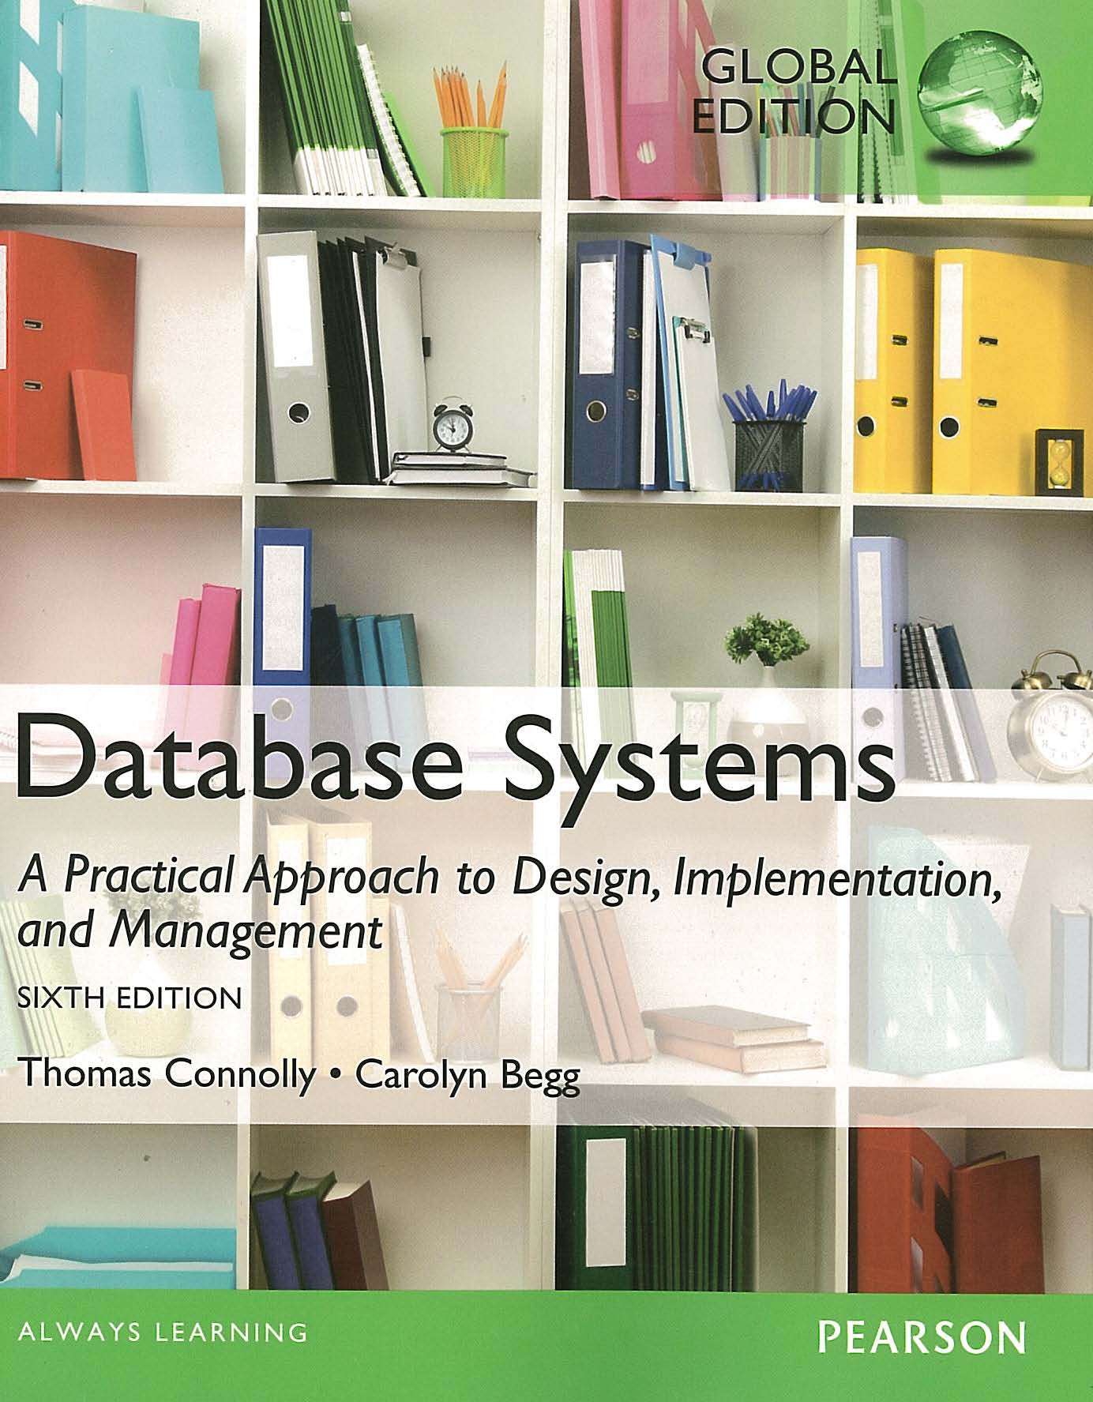
ACKNOWLEDGEMENT
These slides have been adapted from Thomas Connolly and Carolyn Begg. 2015. Database Systems: A Practical Approach To Design, Implementation, and Management. Pearson Education. USA. ISBN:978-1-292-06118-4

Slide 4
CHAPTER 4 THE RELATIONAL MODEL

Slide 5
LEARNING OBJECTIVES
Terminology of relational model.
How tables are used to represent data.
Connection between mathematical relations and relations in the relational model.
Properties of database relations.
How to identify CK, PK, and FKs.
Meaning of entity integrity and referential integrity.

Slide 6
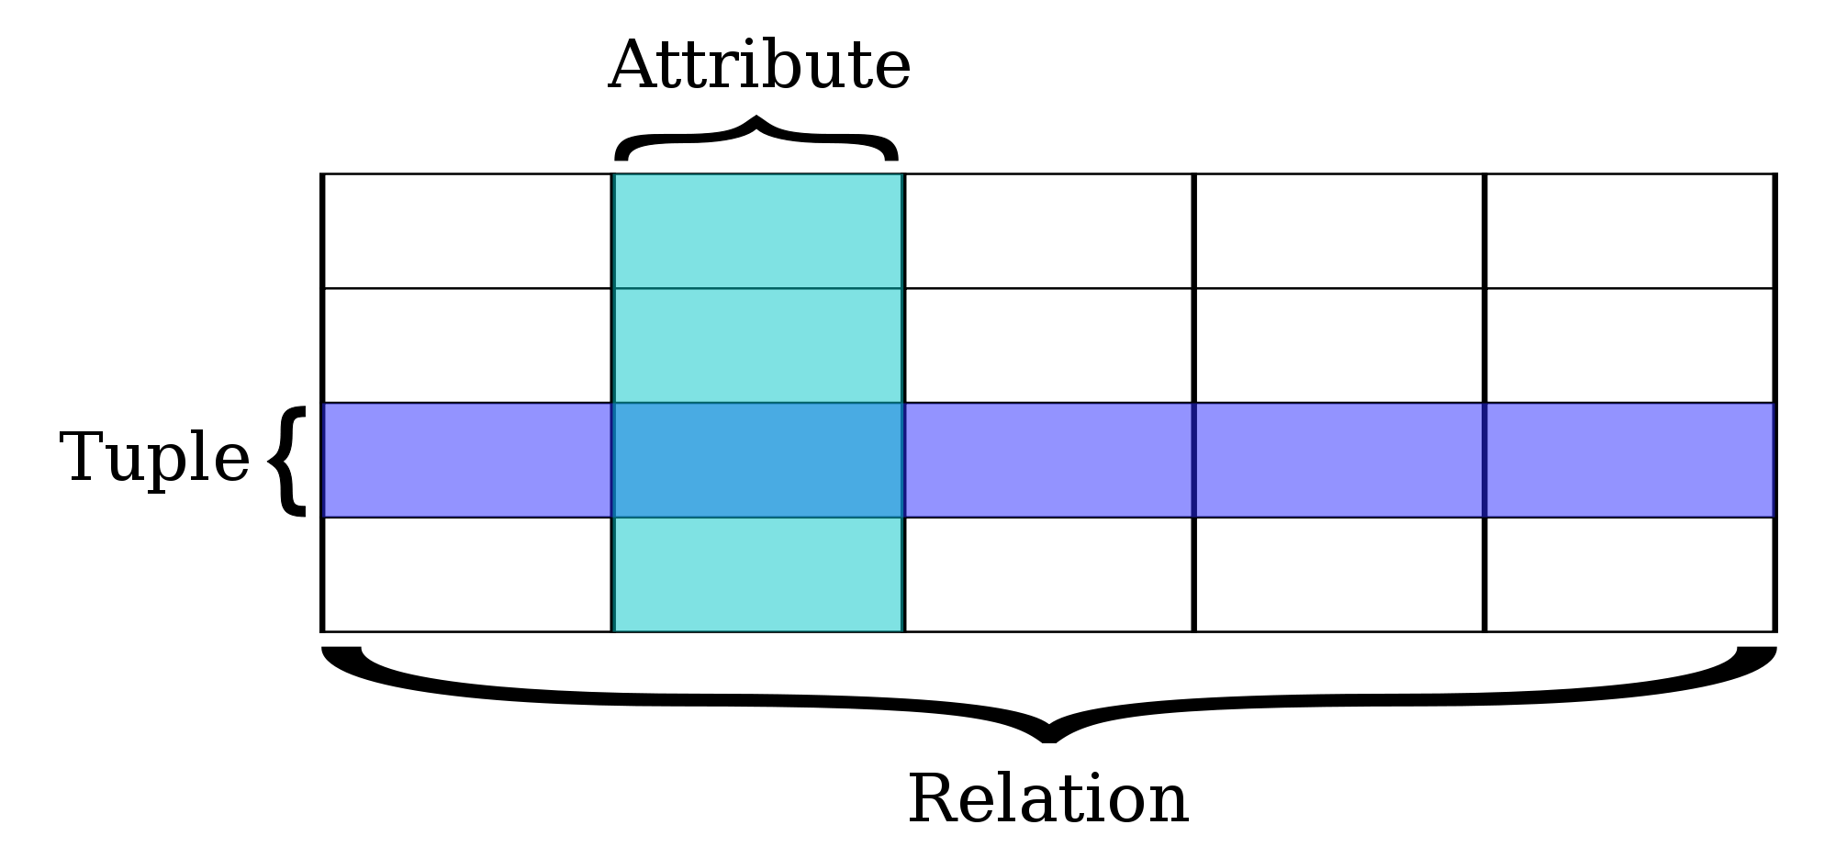
Relational Model Terminology
A relation is a table with columns and rows.
Only applies to logical structure of the database, not the physical structure.
Attribute is a named column of a relation.
Domain is the set of allowable values for one or more attributes.
en.wikipedia.org

Slide 7
Relational Model Terminology
^{Tuple is a row of a relation.}
Degree is the number of attributes in a relation.
Cardinality is the number of tuples in a relation.
Relational Database is a collection of normalized relations with distinct relation names.

Slide 8
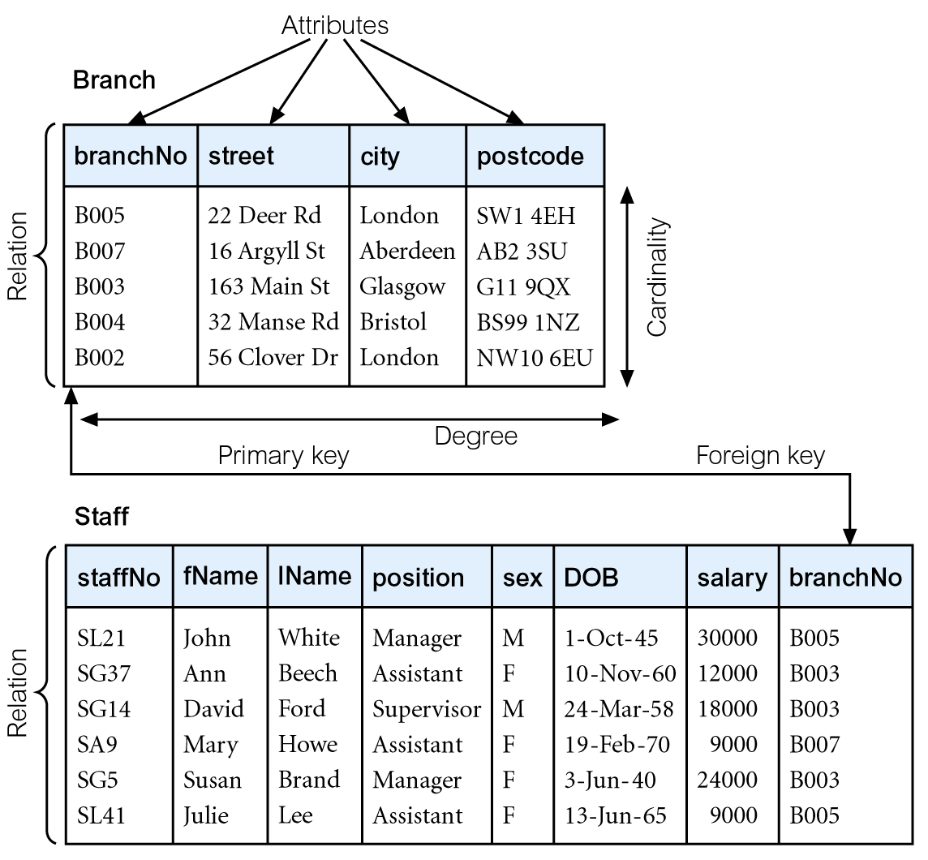
Instances of Branch and Staff Relations
Branch Relation/Table
Degree: 4
Cardinality: 5
Staff Relation/Table
Degree: 8
Cardinality: 6

Slide 9
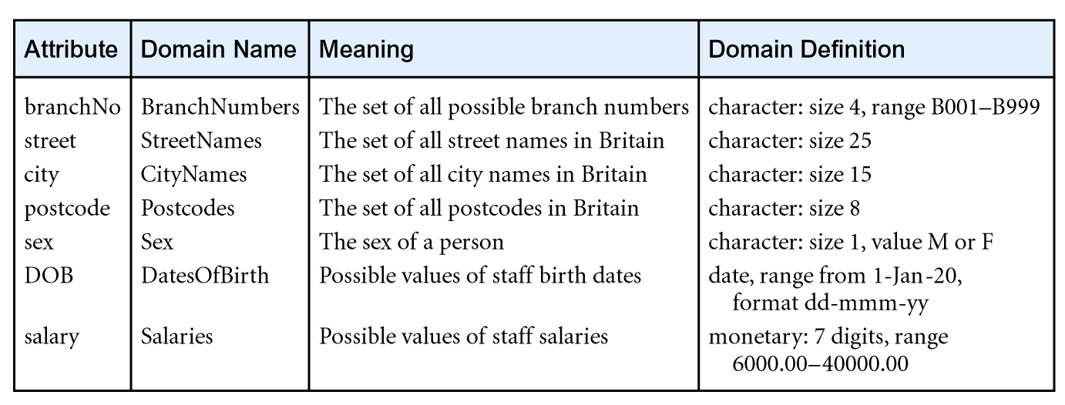
Examples of Attribute Domains

Slide 10
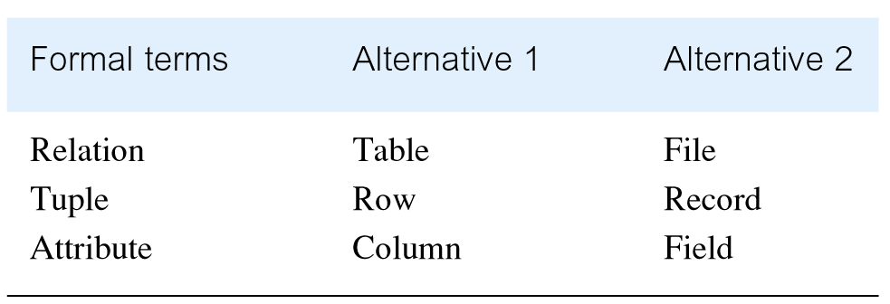
Alternative Terminology for Relational Model

Slide 11
Mathematical Definition of Relation
Consider two sets, D₁ & D₂, where D₁ = {2, 4} and D₂ = {1, 3, 5}.
Cartesian product, D₁ X D₂, is set of all ordered pairs, where first element is member of D₁ and second element is member of D₂.
D₁ X D₂ = {(2, 1), (2, 3), (2, 5), (4, 1), (4, 3), (4, 5)}
Alternative way is to find all combinations of elements with first from D₁ and second from D₂.

Slide 12
Mathematical Definition of Relation
Any subset of Cartesian product is a relation; e.g.
R = {(2, 1), (4, 1)}
May specify which pairs are in relation using some condition for selection; e.g.
second element is 1:
R = {(x, y) | x∈ D₁, y ∈ D₂, and y = 1}
first element is always twice the second:
S = {(x, y) | x ∈ D₁, y ∈ D₂, and x = 2y}

Slide 13
Mathematical Definition of Relation
Consider three sets D₁, D₂, D₃ with Cartesian Product D₁ X D₂ X D₃; e.g.
D₁ = {1, 3} D₂ = {2, 4} D₃ = {5, 6}
D₁ X D₂ X D₃ = {(1,2,5), (1,2,6), (1,4,5), (1,4,6), (3,2,5), (3,2,6), (3,4,5), (3,4,6)}
Any subset of these ordered triples is a relation.

Slide 14
Mathematical Definition of Relation
Cartesian product of n sets (D₁, D₂, . . ., D_{n}) is:
D₁ X D₂ X . . . X D_{n} = {(d₁, d₂, . . . , d_{n}) | d₁ ∈ D₁, d₂ ∈ D₂, . . . , d_{n} ∈ D_{n}}
usually written as:
n
X D_{i}
^{i = 1}
Any set of n-tuples from this Cartesian product is a relation on the n sets.

Slide 15
Database Relations
Relation schema
Named relation defined by a set of attribute and domain name pairs.
Relational database schema
Set of relation schemas, each with a distinct name.

Slide 16
Properties of Relations
Relation name is distinct from all other relation names in relational schema.
Each cell of relation contains exactly one atomic (single) value.
Each attribute has a distinct name.
Values of an attribute are all from the same domain.
Each tuple is distinct; there are no duplicate tuples.
Order of attributes has no significance.
Order of tuples has no significance, theoretically.

Slide 17

Relational Keys
www.cincinnatireview.com
Superkey
An attribute, or set of attributes, that uniquely identifies a tuple within a relation.
Candidate Key
Superkey (K) such that no proper subset is a superkey within the relation.
In each tuple of R, values of K uniquely identify that tuple (uniqueness).
No proper subset of K has the uniqueness property (irreducibility).

Slide 18
Relational Keys
Primary Key
Candidate key selected to identify tuples uniquely within relation.
Based on slide 8: branchNo is primary key of Branch relation and staffNo is primary key of Staff relation.
Alternate Keys
Candidate keys that are not selected to be primary key.
Foreign Key
Attribute, or set of attributes, within one relation that matches candidate key of some (possibly same) relation.
Based on slide 8, branchNo is foreign key of Staff relation.

Slide 19
Integrity Constraints
Null
Represents value for an attribute that is currently unknown or not applicable for tuple.
Deals with incomplete or exceptional data.
Represents the absence of a value and is not the same as zero or spaces, which are values.
Entity Integrity
In a base relation, no attribute of a primary key can be null.
Based on slide 8: branchNo is primary key of Branch relation and staffNo is primary key of Staff relation. Both of them cannot have null value.

Slide 20
Integrity Constraints
Referential Integrity
If foreign key exists in a relation, either foreign key value must match a candidate key value of some tuple in its home relation or foreign key value must be wholly null.
Based on slide 8, branchNo is foreign key of Staff relation. So its value must refer to branchNo of Branch relation or null value.
General Constraints
Additional rules specified by users or database administrators that define or constrain some aspect of the enterprise.

Slide 21

www.healthytravelblog.com

